Slide 1


Slide 2
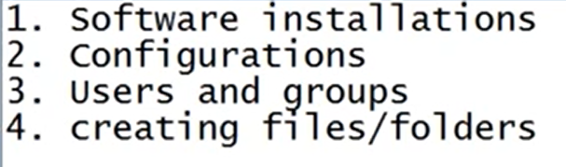
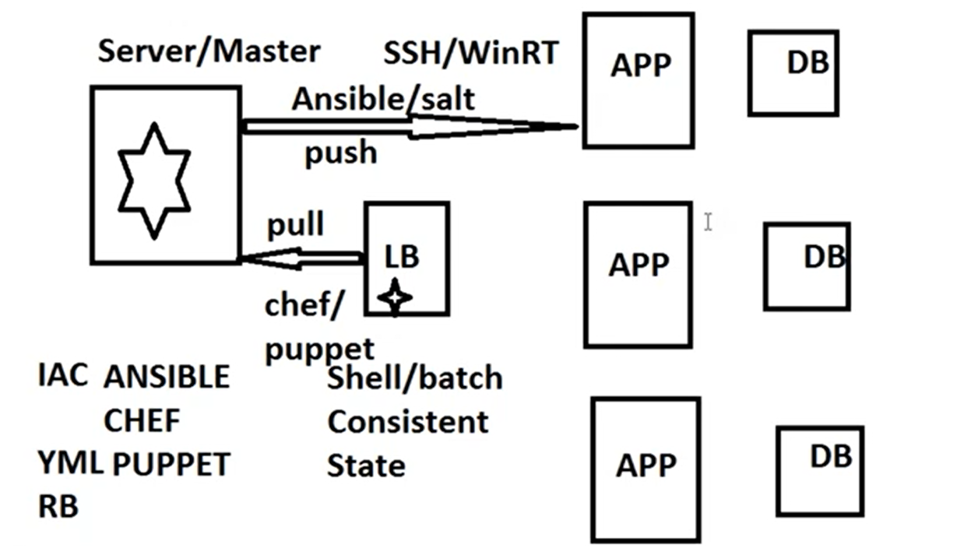
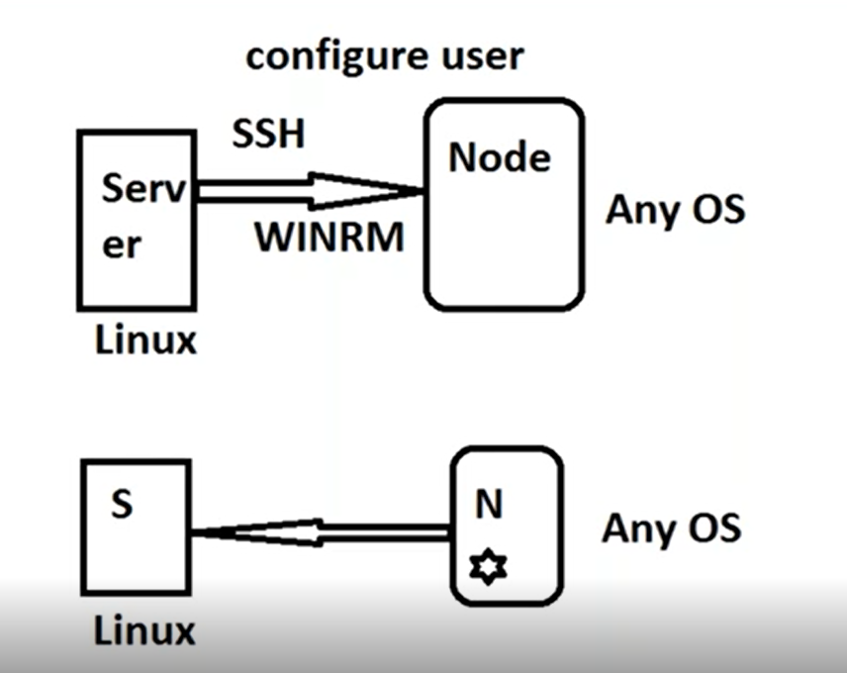

Slide 3


Slide 4
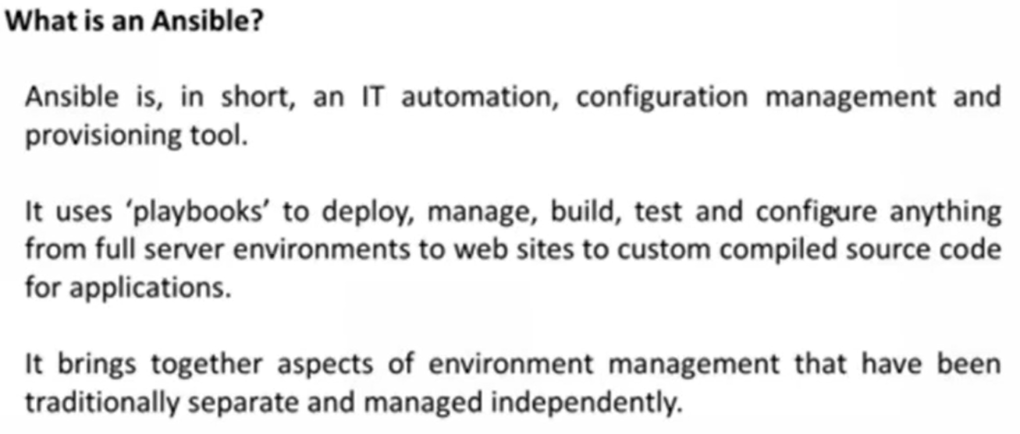

Slide 5
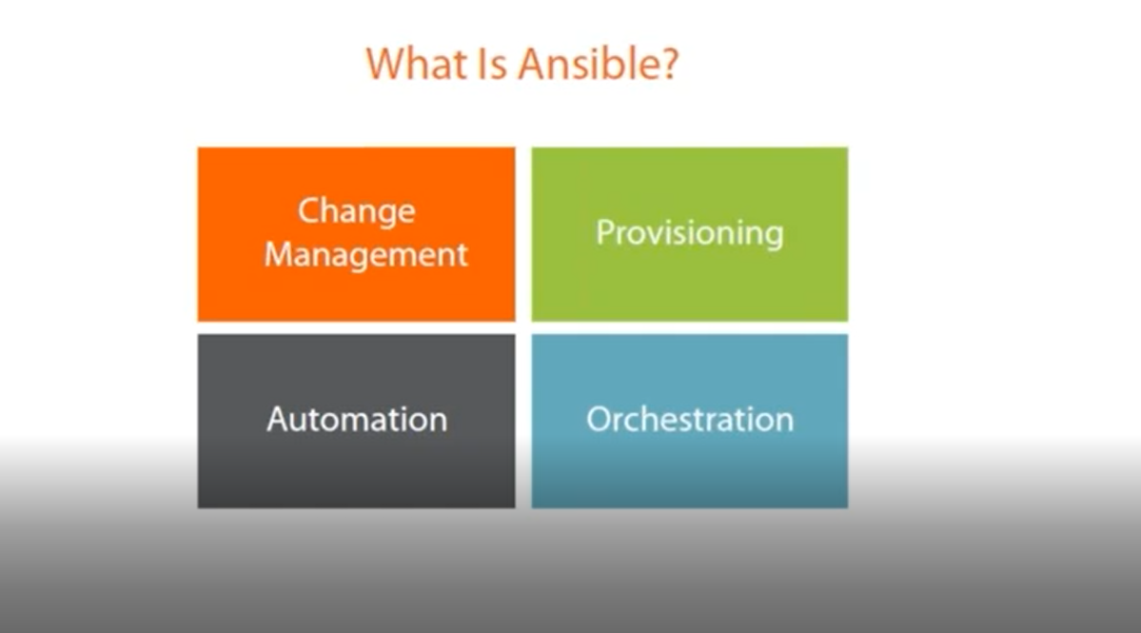

Slide 6
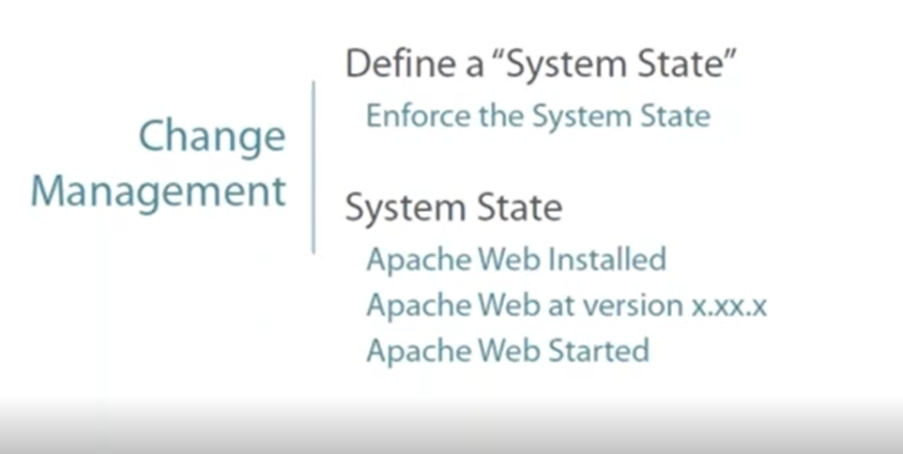

Slide 7
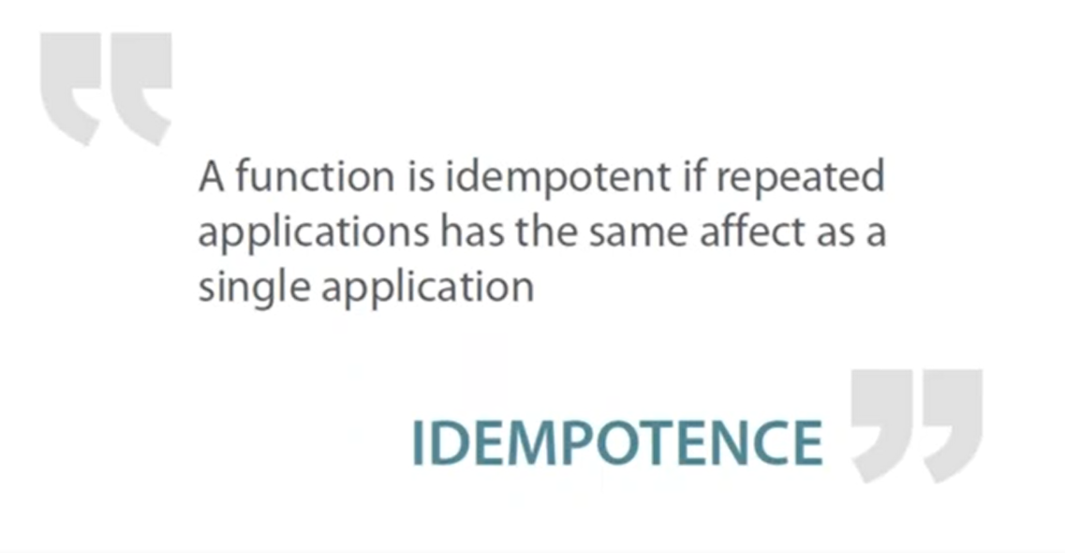

Slide 8
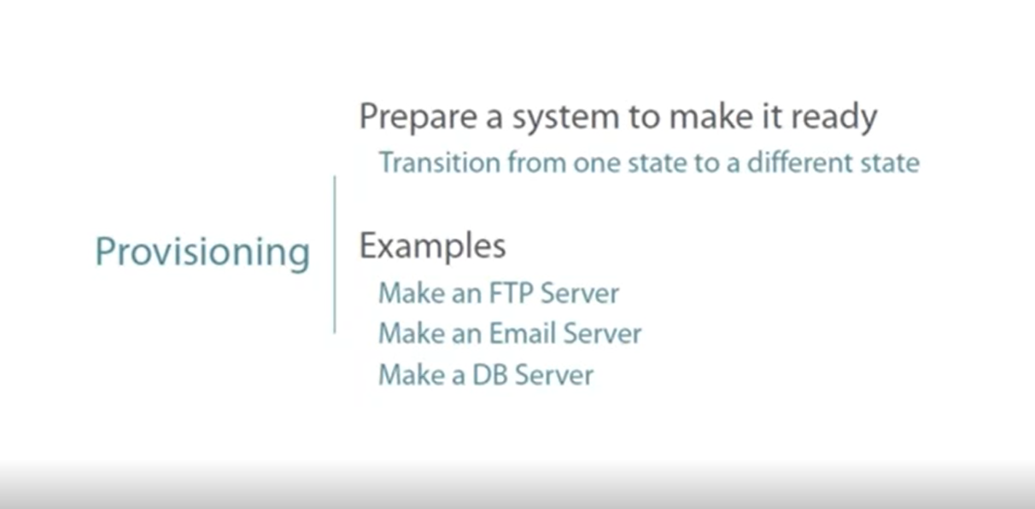

Slide 9
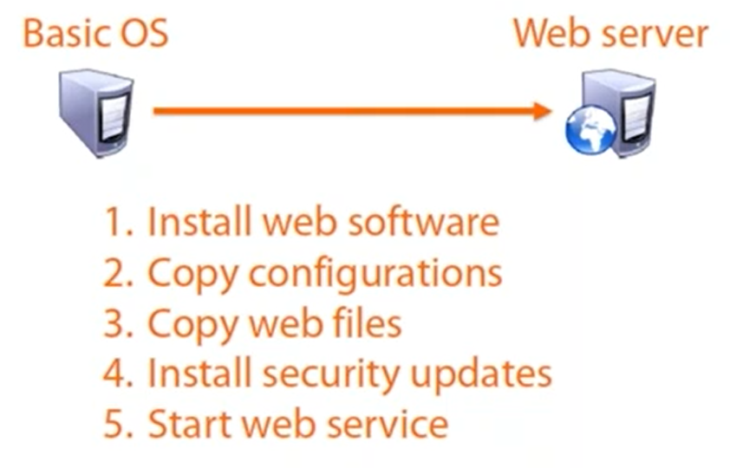

Slide 10
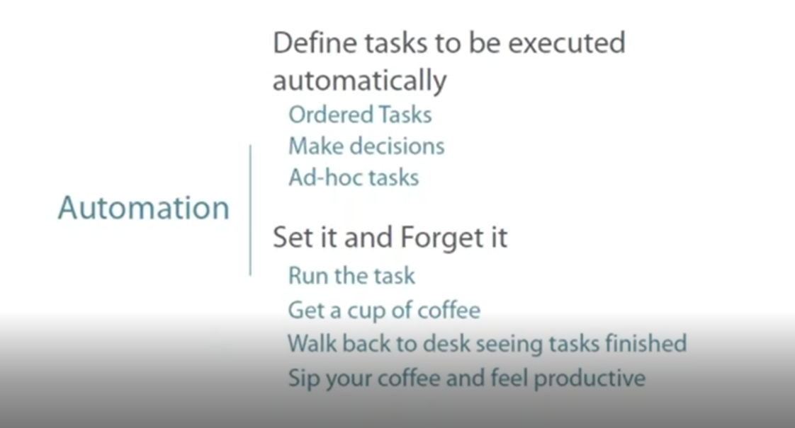

Slide 11
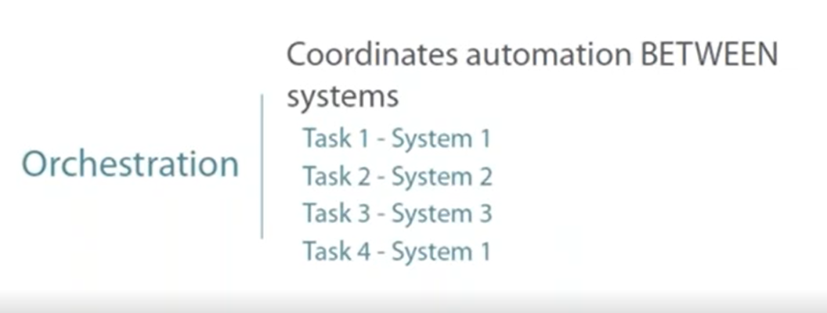

Slide 12


Slide 13
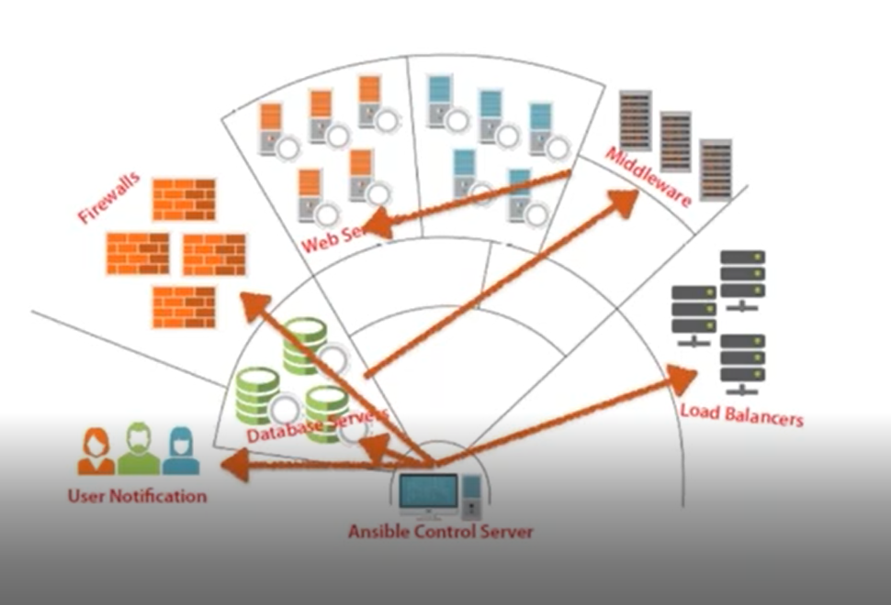
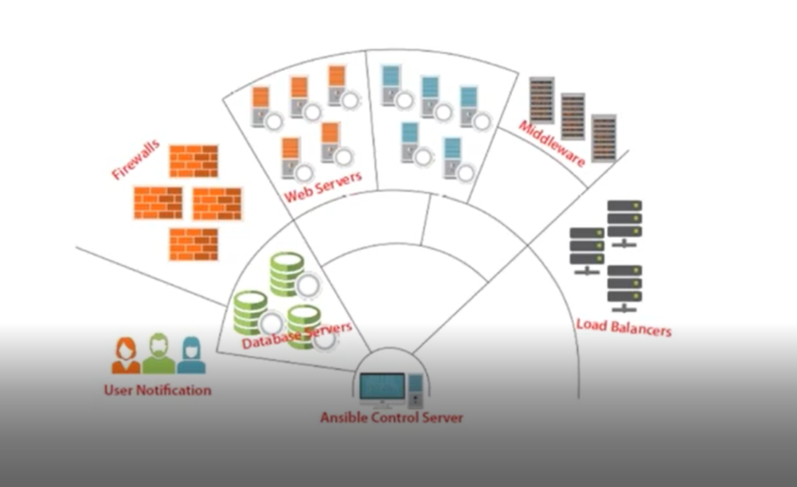

Slide 14


Slide 15
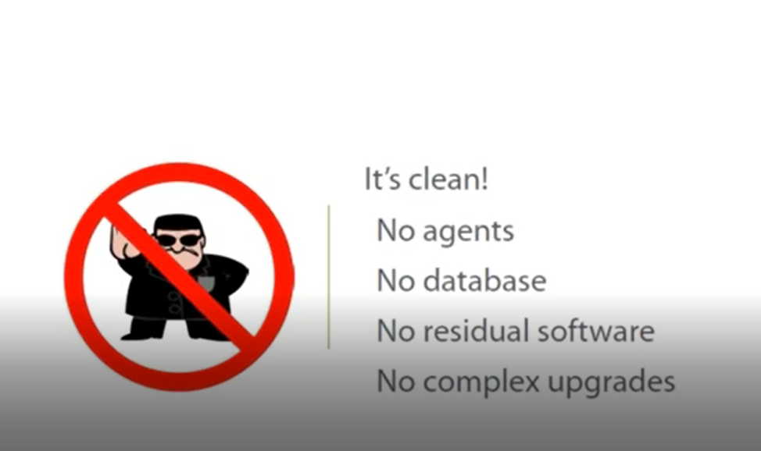

Slide 16
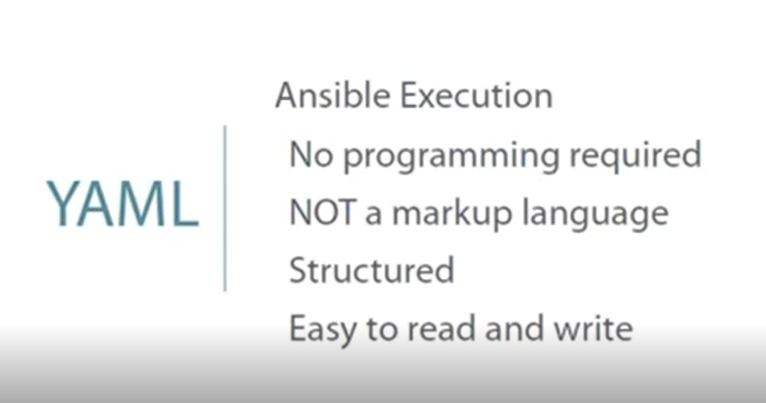

Slide 17
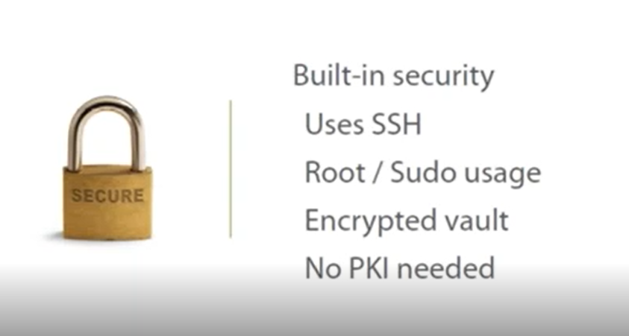

Slide 18
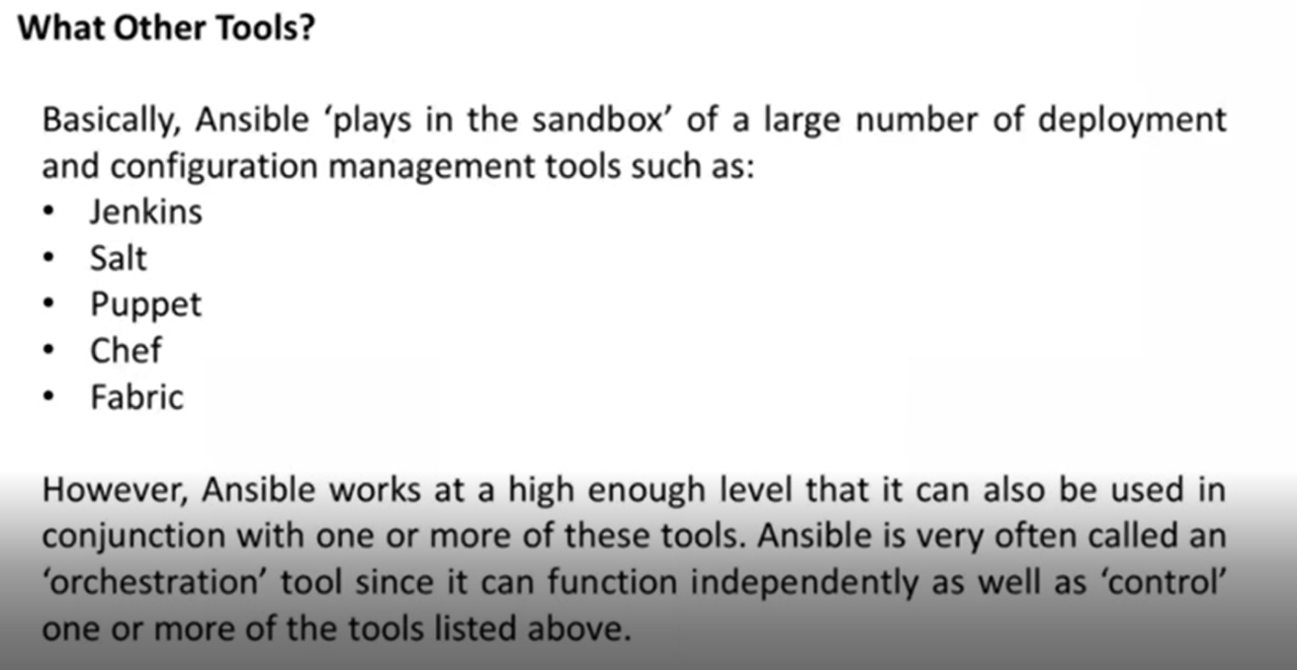

Slide 19
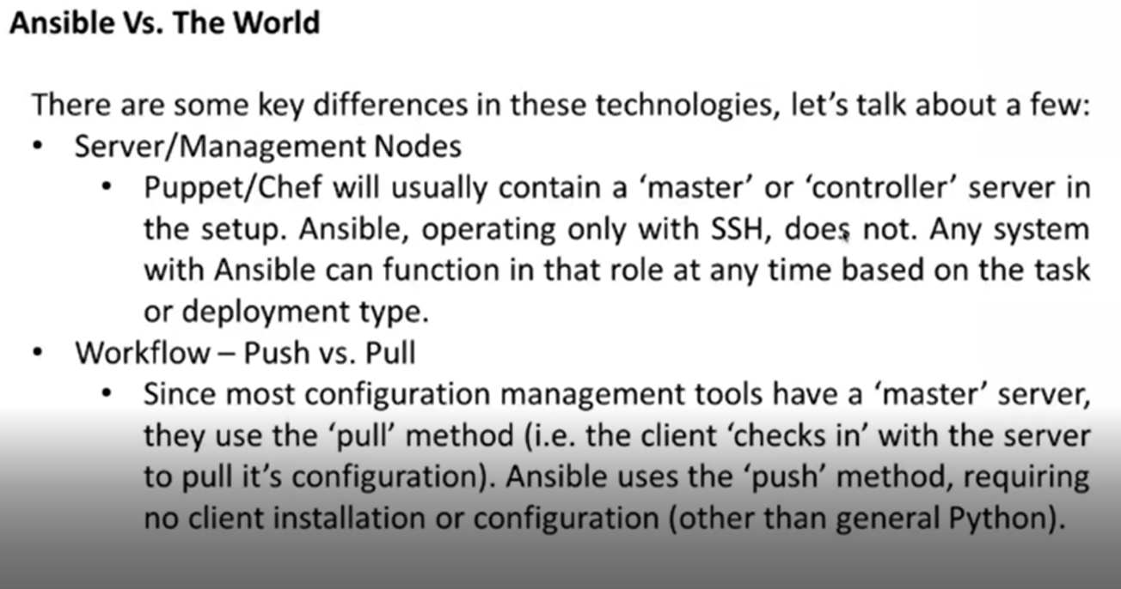

Slide 20
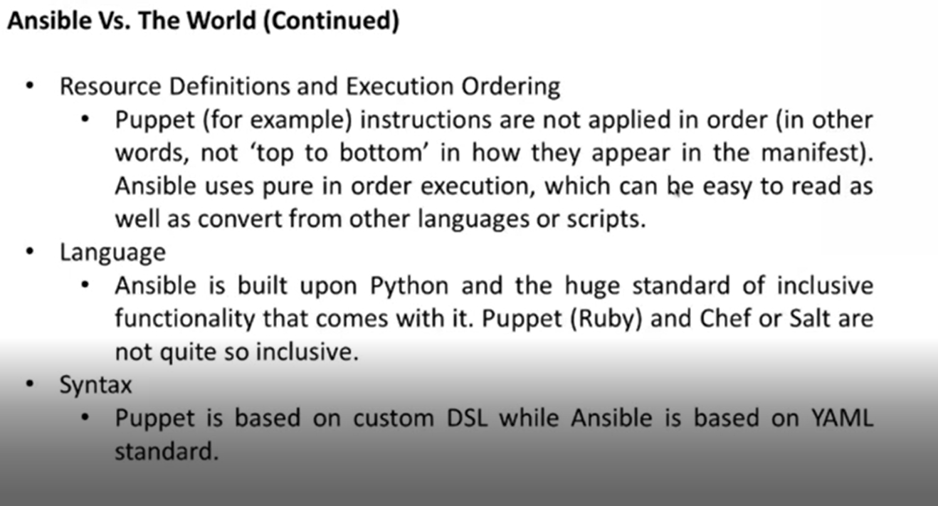

Slide 21
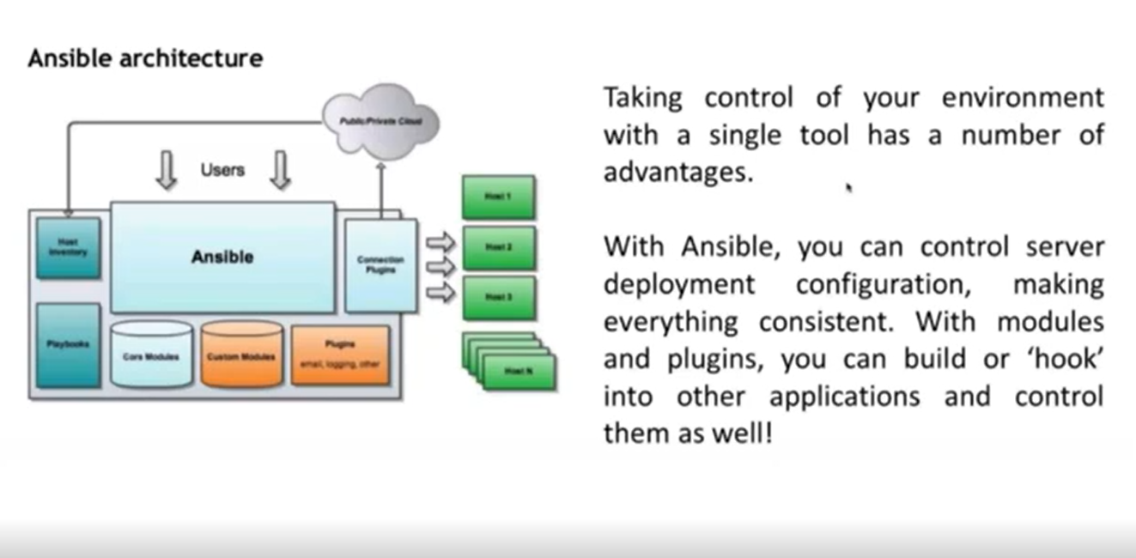

Slide 22
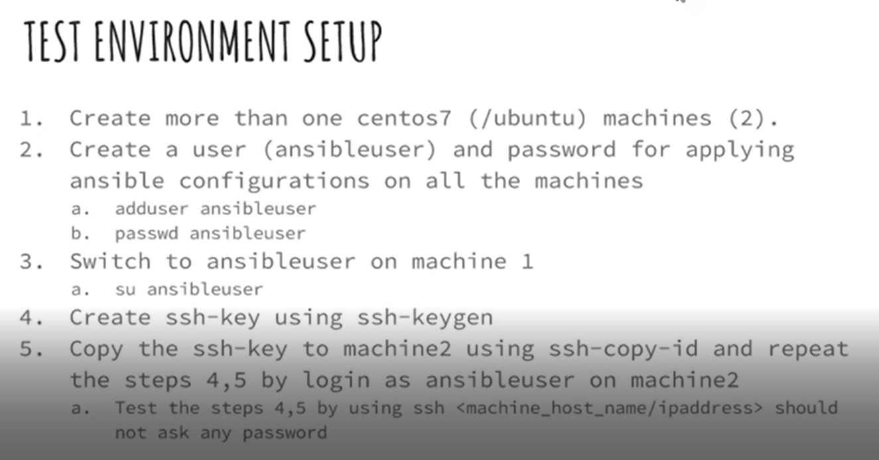

Slide 23
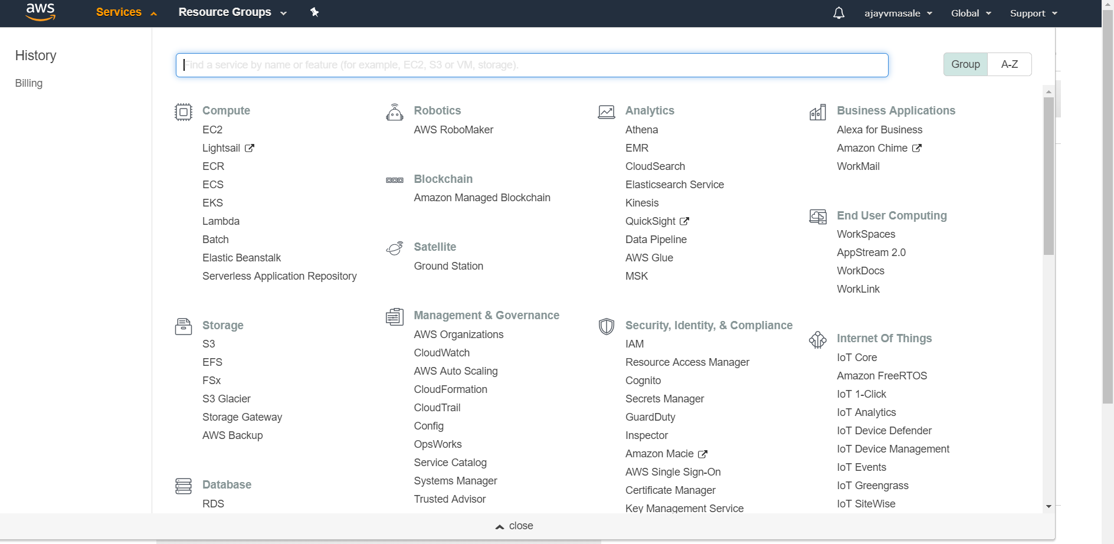

Slide 24
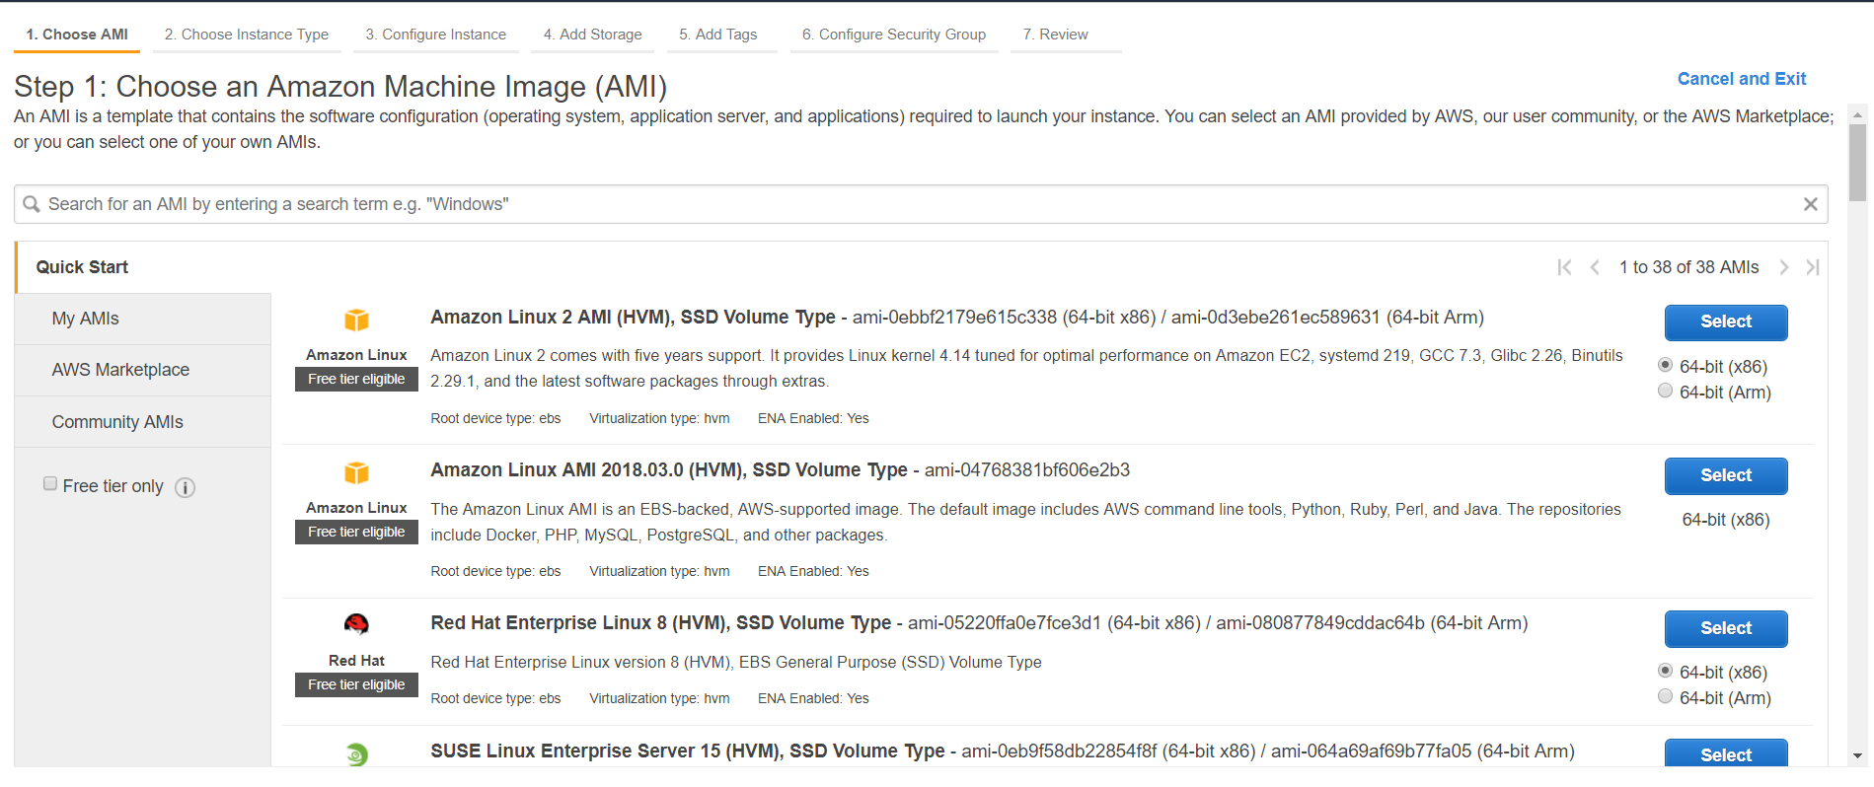

Slide 25
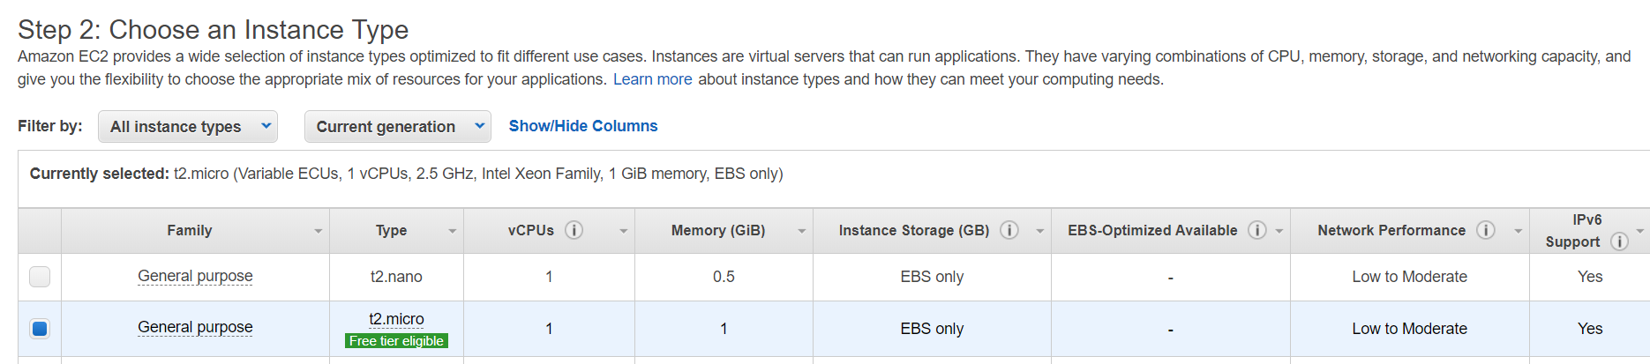
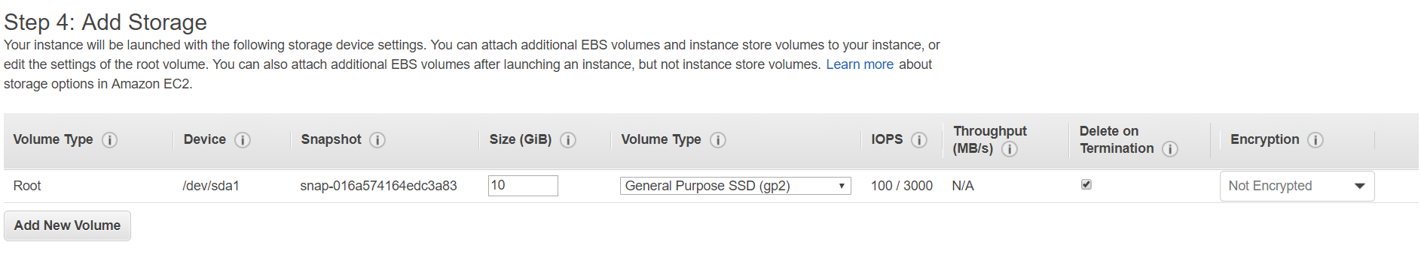
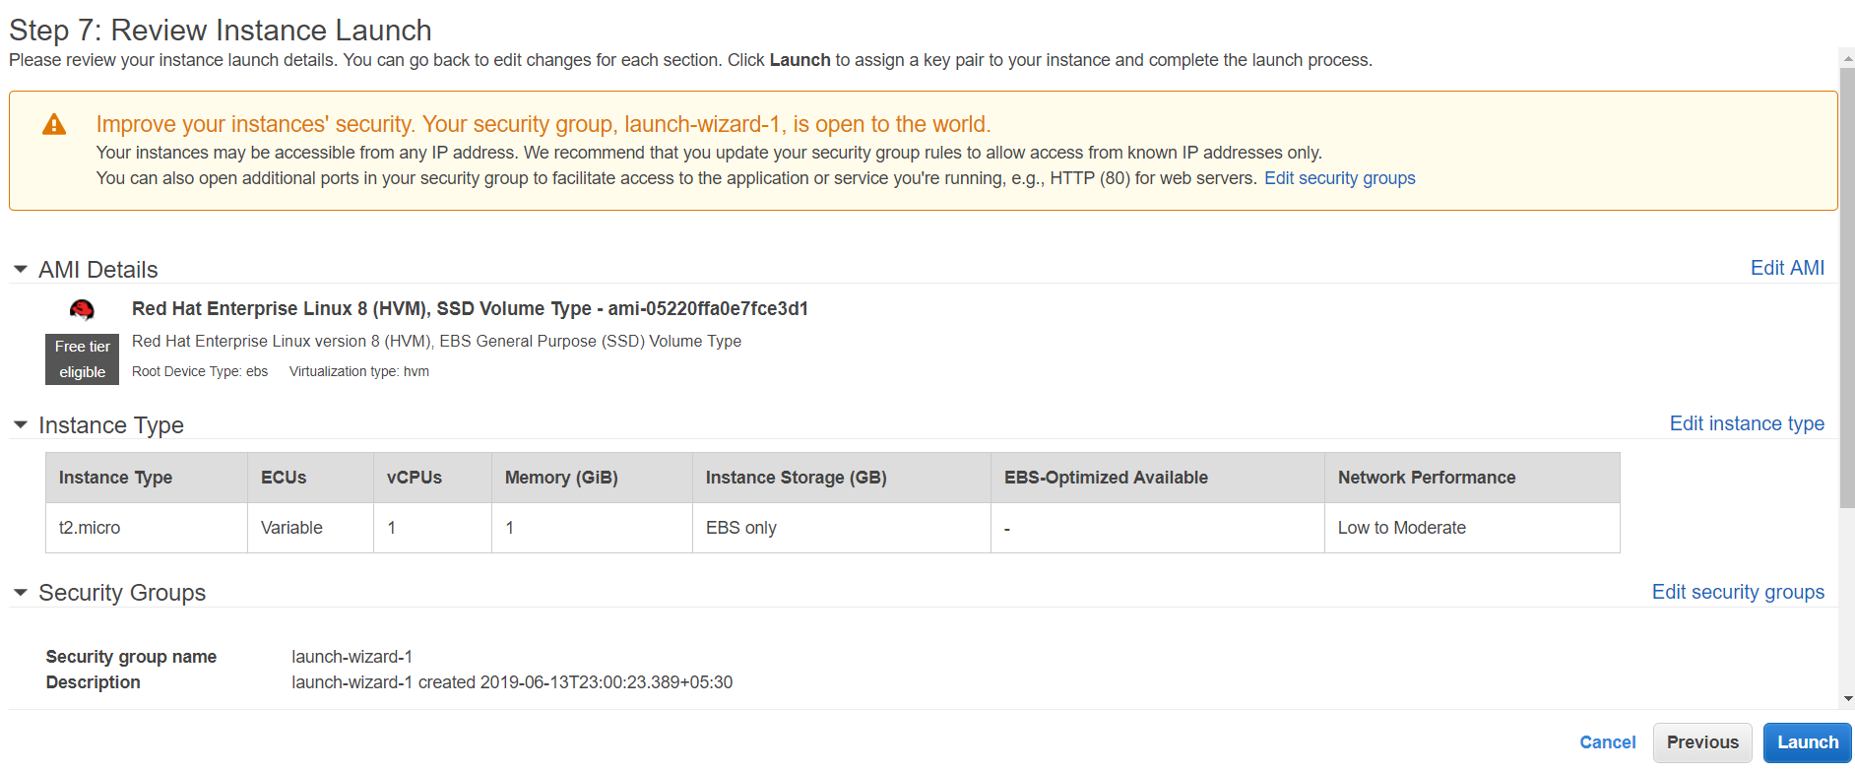
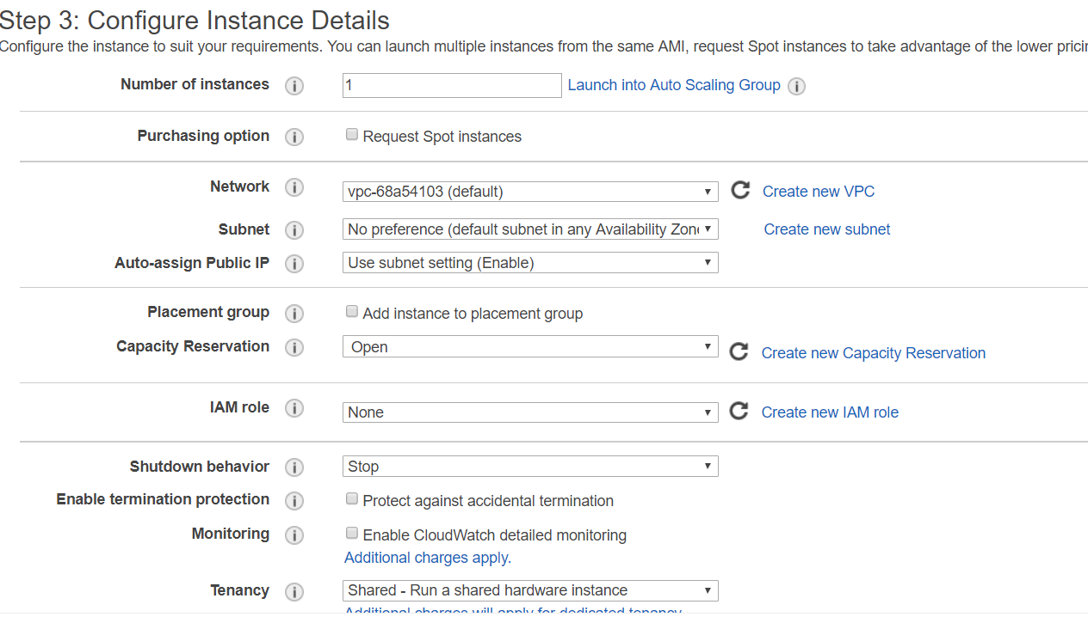
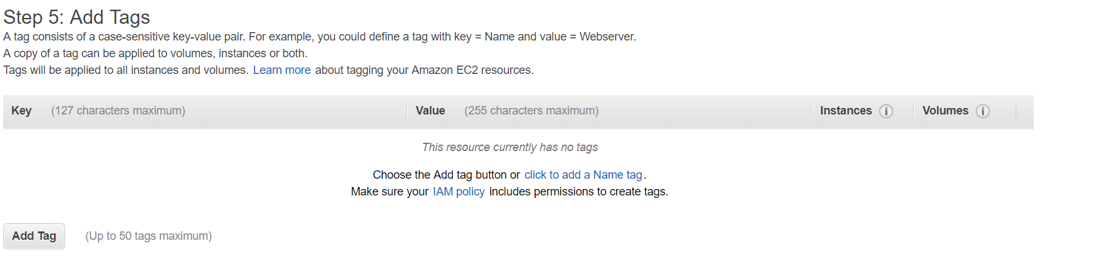
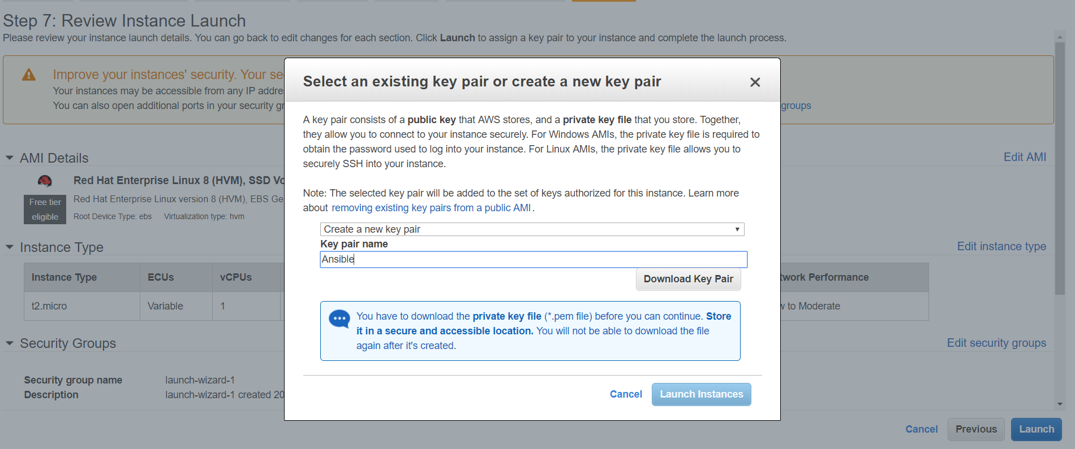
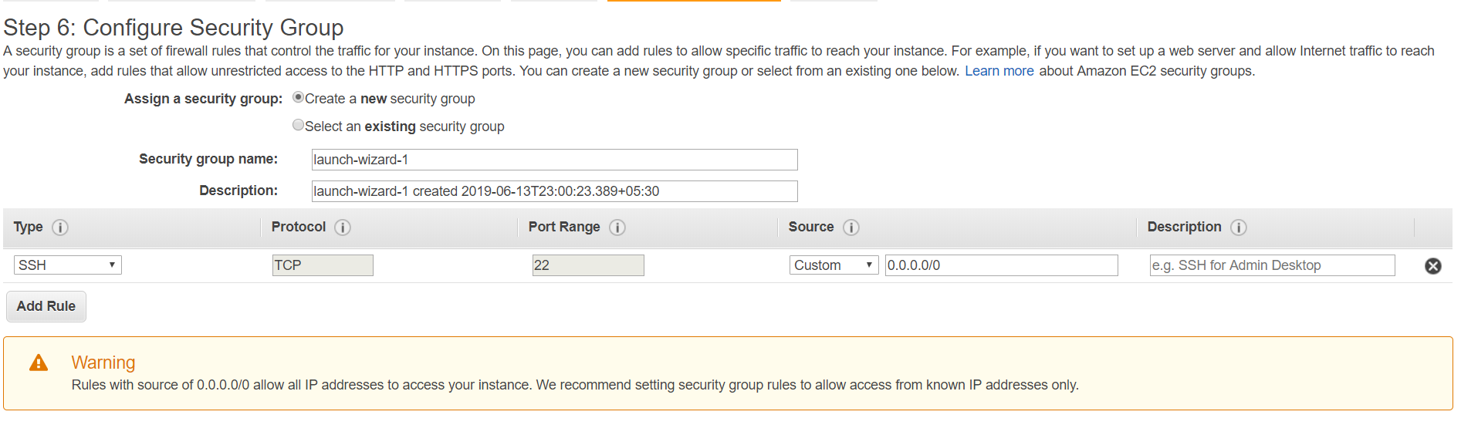


Slide 26
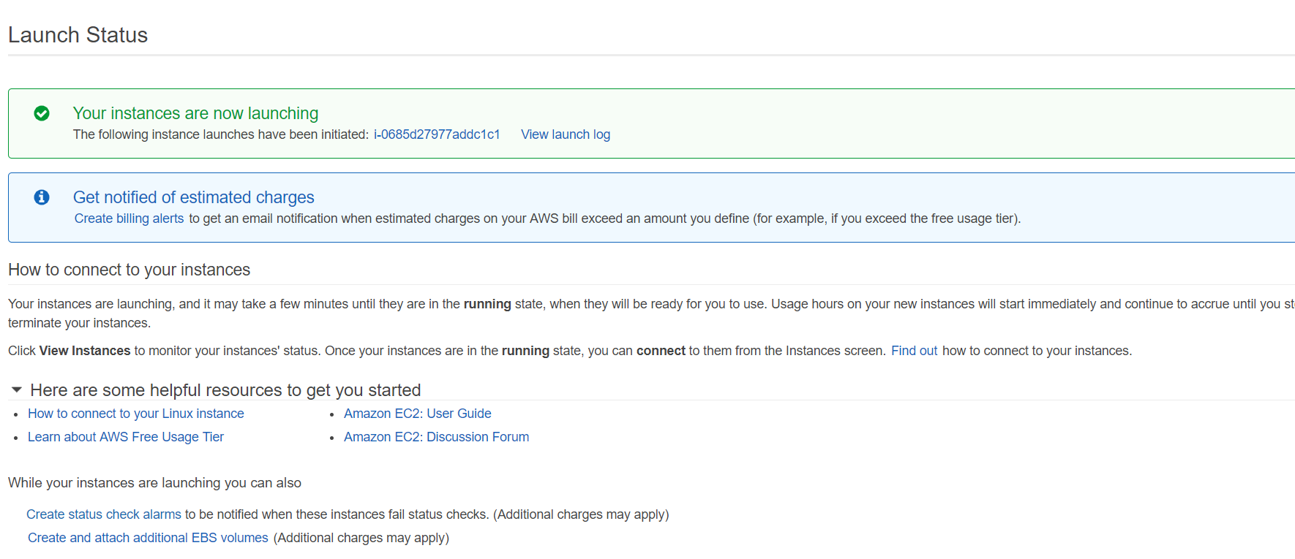
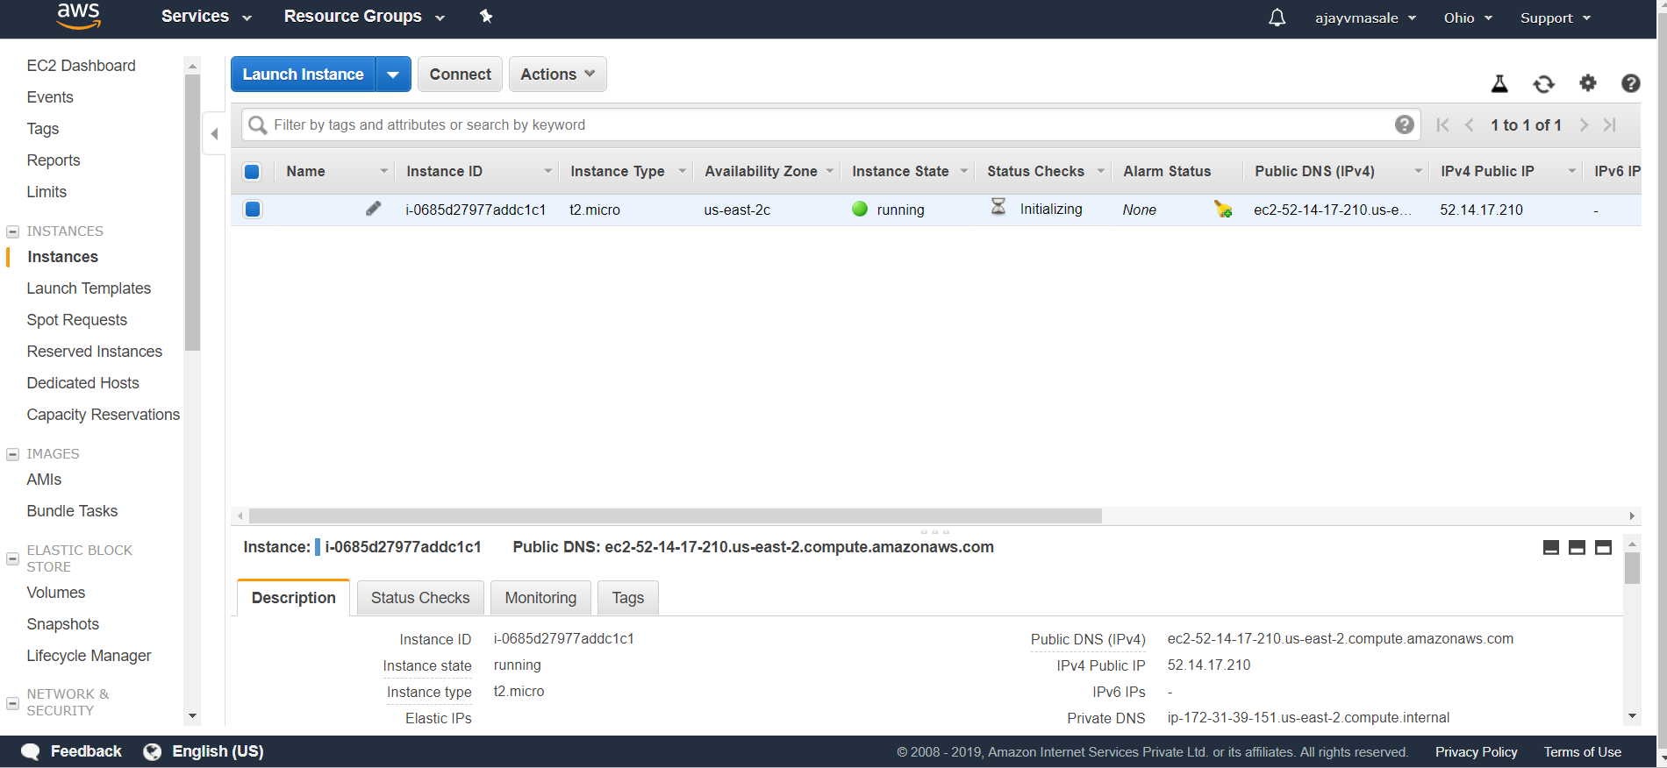

Slide 27
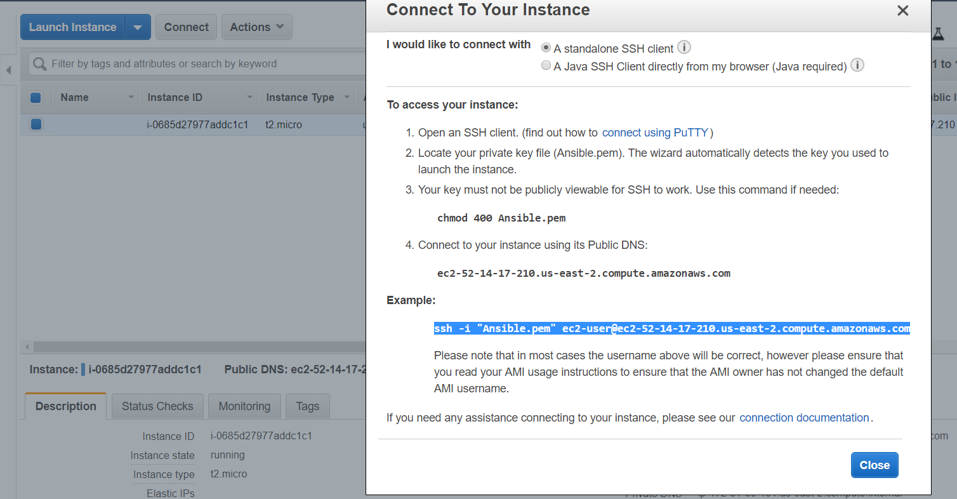
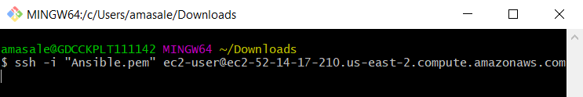
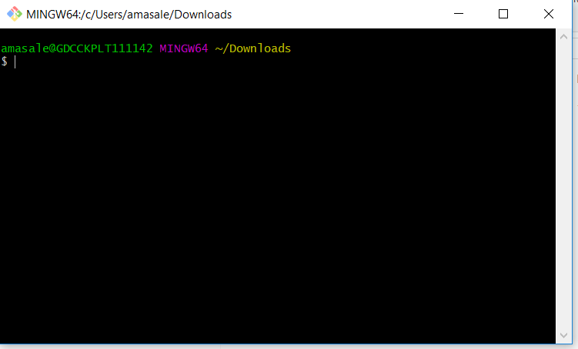
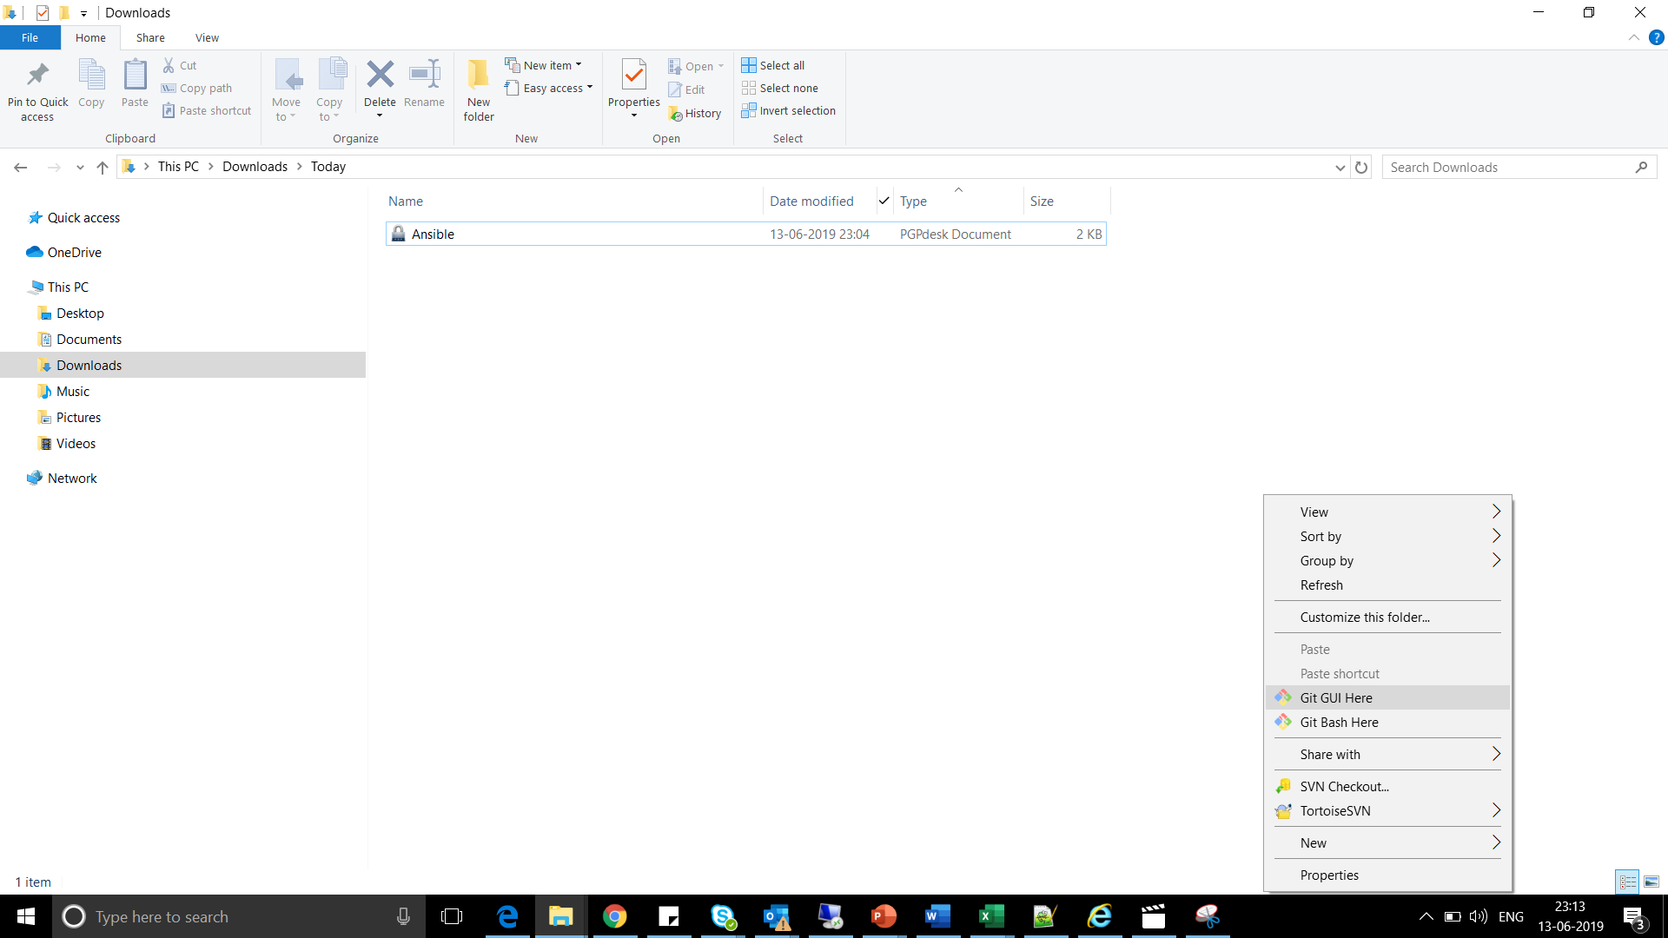
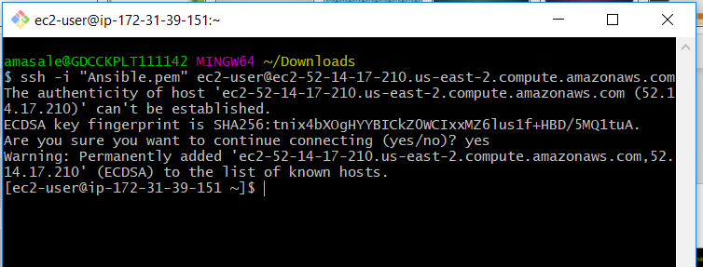

Slide 28
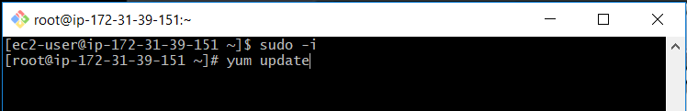
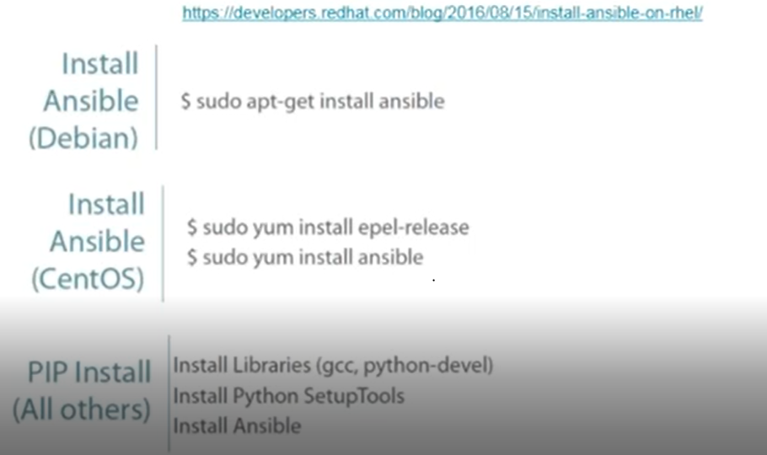
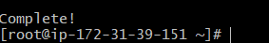
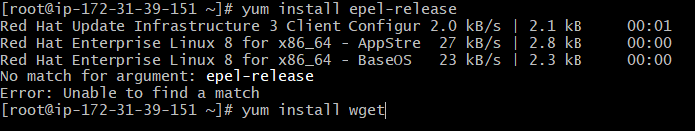
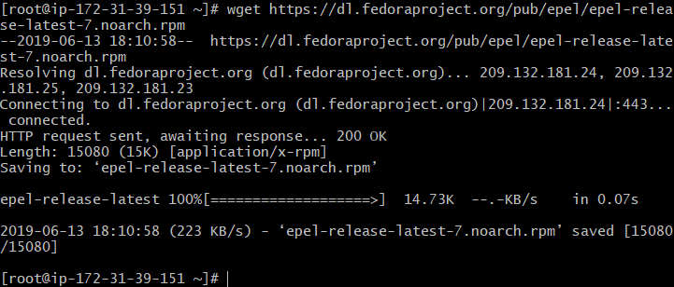
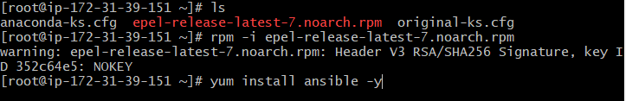

Slide 29
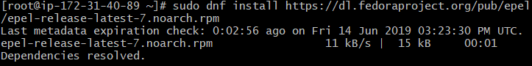
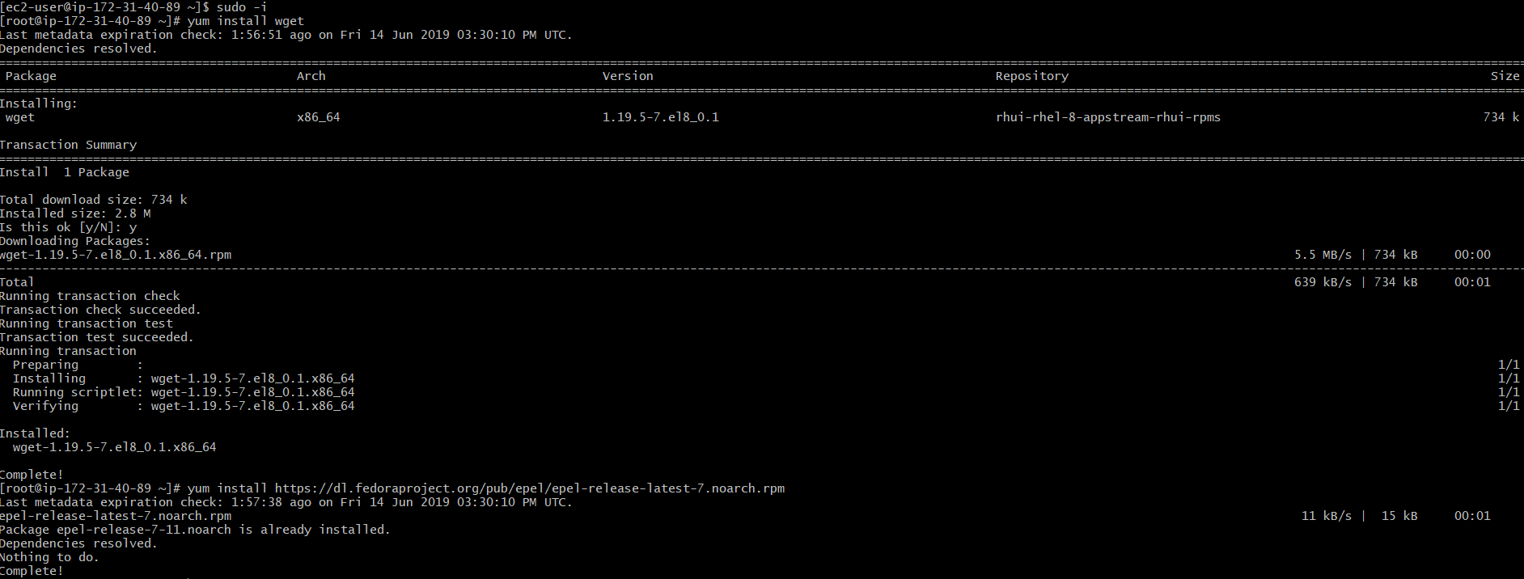

Slide 30
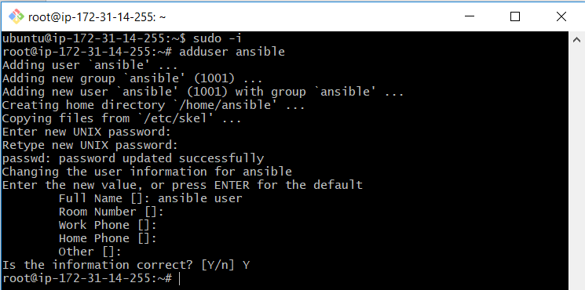
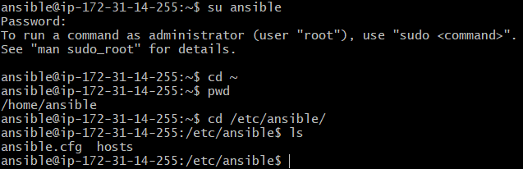
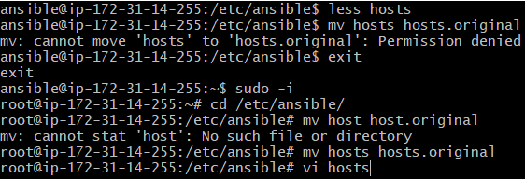
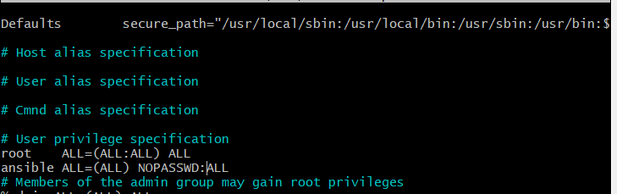
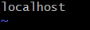


Configure Ansible : Create user

Slide 31



Configure Ansible : Create user (Cont…)

Slide 32

Create a node instance for Ansible and then Create ansible user

Slide 33




Add Node’s Private DNS details to original Master’s /etc/ansible/hosts file

Slide 34


Summary of Ansible Setup on Server and Node

Slide 35

What does ANSIBLE includes?

Slide 36

Core Components: Inventories and Modules

Slide 37

Core Components: Variables

Slide 38

Core Components: Ansible Facts and Playbooks

Slide 39

Core Components: Configuration Files and Templates

Slide 40

Core Components: Handlers and Roles

Slide 41

Core Components: Ansible Vault

Slide 42


Slide 43


Slide 44


Slide 45


Slide 46


Slide 47


Slide 48



Slide 49


Slide 50


Slide 51


Slide 52


Other Way : Direct download and install from internet

Slide 53




Slide 54


Slide 55


Slide 56


Slide 57


Slide 58


Slide 59


Slide 60



Slide 61




Slide 62


Slide 63


Slide 64


Slide 65


Slide 66



Slide 67

Command Module Example

Slide 68



Playbook for command: whoami and ping

Slide 69



Append Commands in YAML

Slide 70


Install software packages in YAML using command

Slide 71



Install software package using Playbook

Slide 72


Uninstall software packages using Playbook

Slide 73


Slide 74


Uninstall using Playbook

Slide 75


Install Apache Server using Playbook

Slide 76





Check if Apache Web Server is up and running

Slide 77


Slide 78


Slide 79


Slide 80


Slide 81






Sample Inventory file like Hosts

Slide 82


Slide 83




Create a folder for Group Variables in Inventory folder to maintain Group variables in files

Slide 84


Create a folder for Host Variables in Inventory folder to maintain Hosts variables in files

Slide 85


Slide 86


Slide 87






Create First Inventory File

Slide 88



Check ifconfig command using Ansible Playbook file

Slide 89

Install OpenJDK and Tomcat for Jenkins Setup

Slide 90




Slide 91


Download Jenkins war file and copy link path

Slide 92

Install Git on Ansible Master

Slide 93

Clone ansible playbook folder from git to Ansible Master

Slide 94

Run playbook

Slide 95

Run Playbook (Cont…)

Slide 96

Ssh to ubantu machine and check if open jdk is installed or not

Slide 97

Create playbook for installing nginx

Slide 98

Playbook for nginx installation

Slide 99

Edit group entry in myhosts file

Slide 100

Run the nginx.yaml playbook

Slide 101

Understanding json format: Sample json file

Slide 102



Ansible facts: setup json file and apply filter

Slide 103


Don’t want to facts

Slide 104



Get verbosity through facts

Slide 105



How to get variable values from playbook

Slide 106




Create a dynamic variables

Slide 107



Edit Group_Vars files and see if variable value is updated or not

Slide 108




Host_Vars files in ansible playbook

Slide 109



Check the service status

Slide 110






Conditionals: When

